Slide 1
Lead Score case study
Girish, Saurabh and Monika

Slide 2
Steps
Data Cleaning
Univariate Analysis
Bivariate Analysis
Exploratory data Analysis
Feature Engineering
Converting categorical columns to dummies
Identifying and dropping highly correlated columns (>0.7)
Model Building
Feature Selection through RFE
Rebuilding Model based on VIF and P value analysis
ROC and Determining Optimal Cut off Point
Model Evaluation
Validating Cut off point Using Precision & Recall Curve
Predicting test datasets
Comparing Performance of Train v/s Test data set

Slide 3
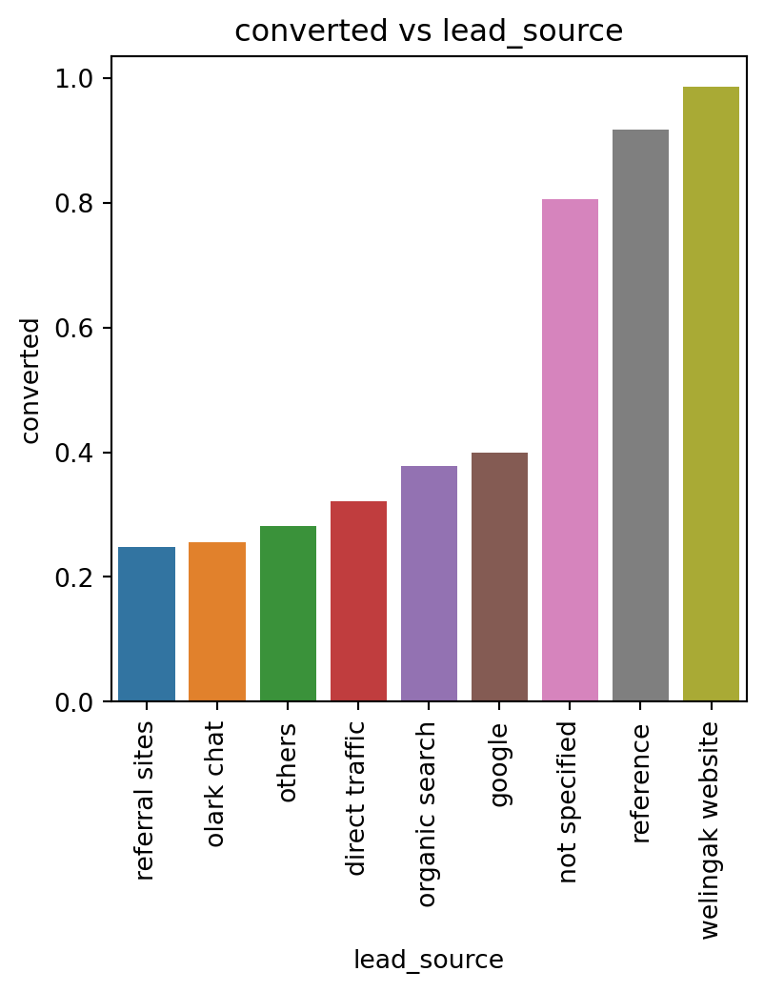
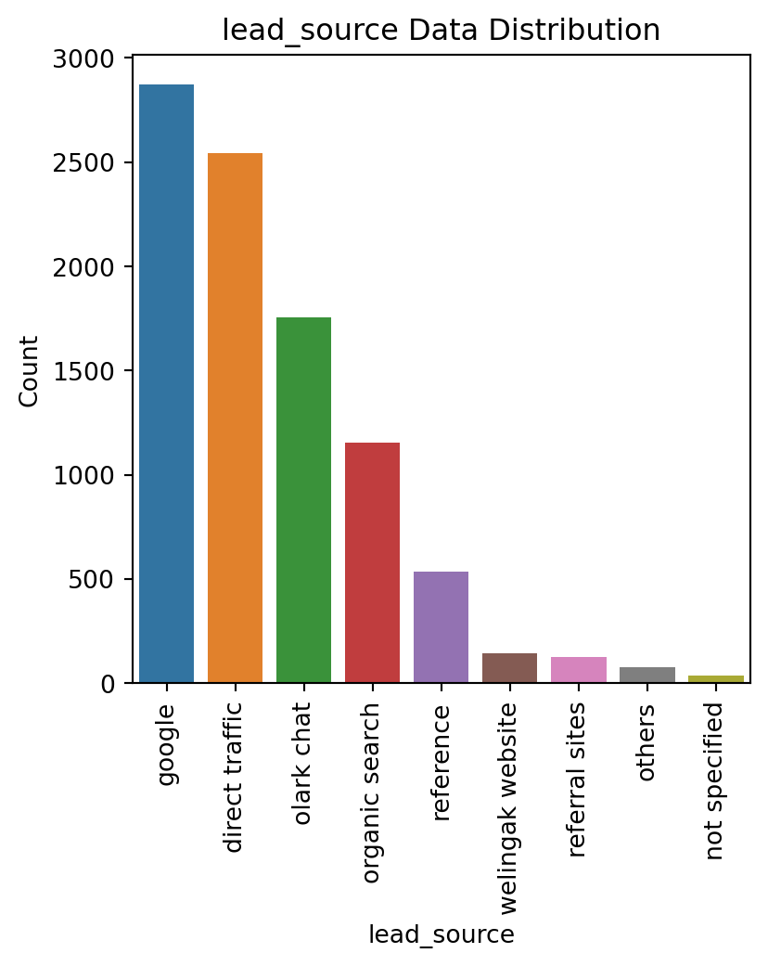
Insights From EDA
Lead Source
Though Leads from is High, Conversion is low
Conversly, Leads from Reference is low, but Conversion is High

Slide 4
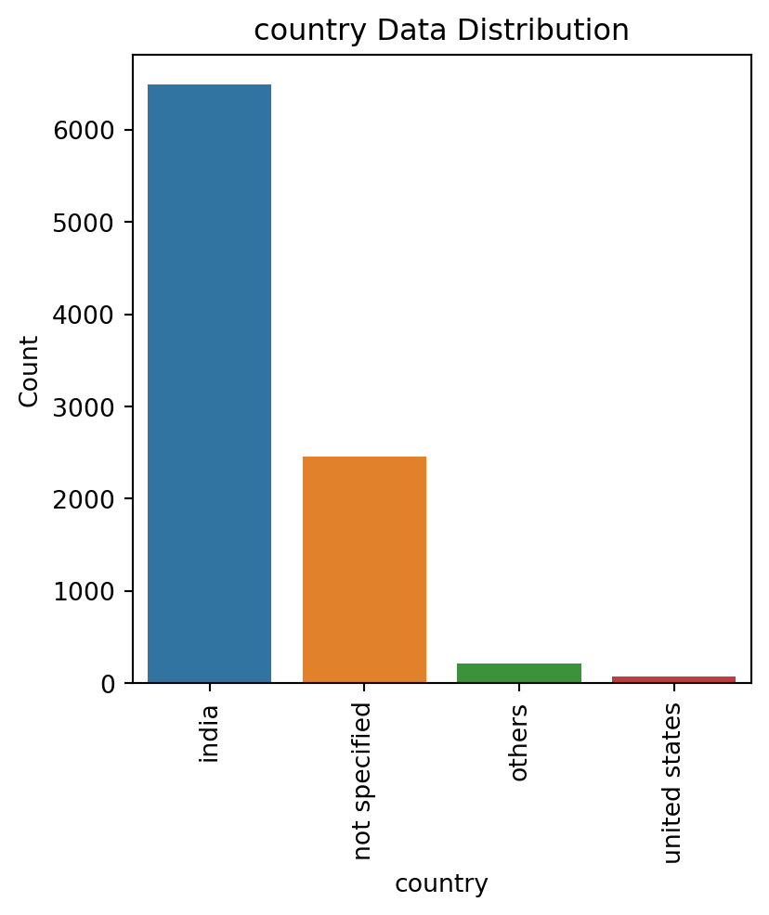
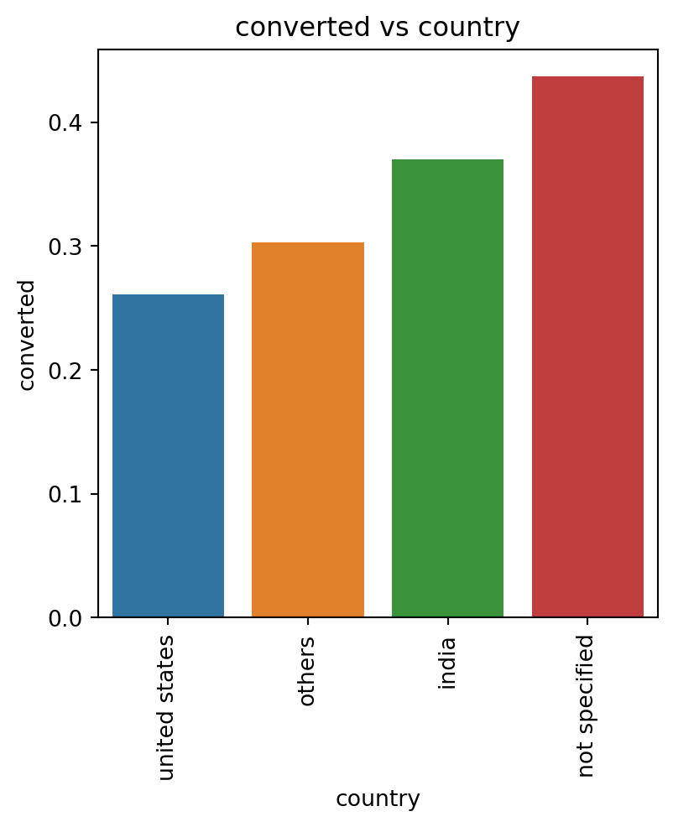
Insights From EDA
Country
Leads from India is High
Conversion rate of india is also High
When user doesn’t specify country, Its Safe to assume that they belong to india as almost 75% leads are from india

Slide 5
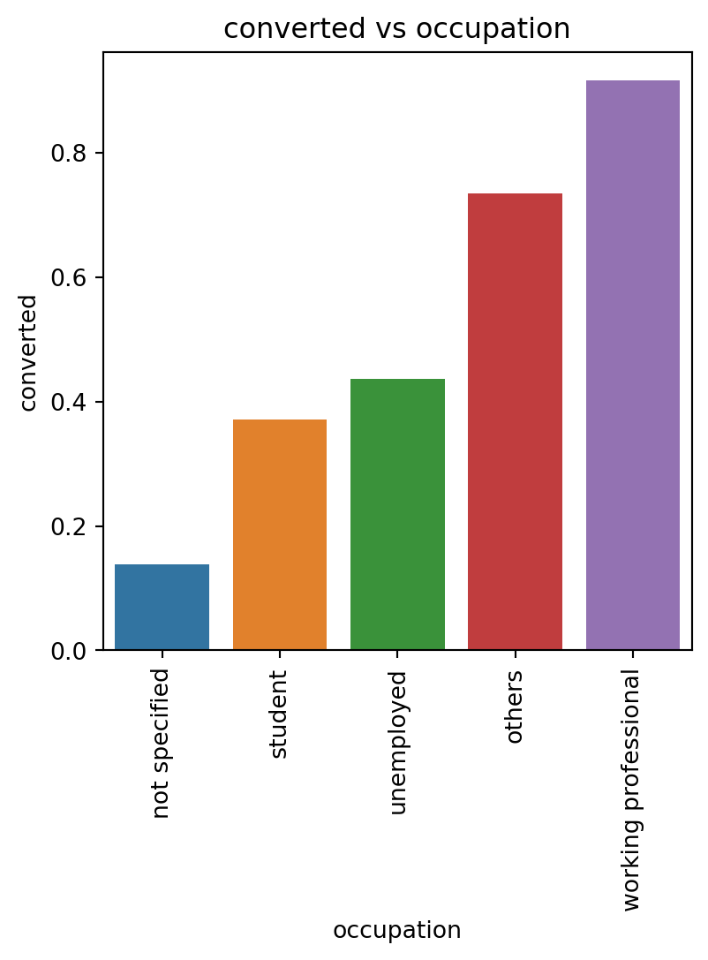
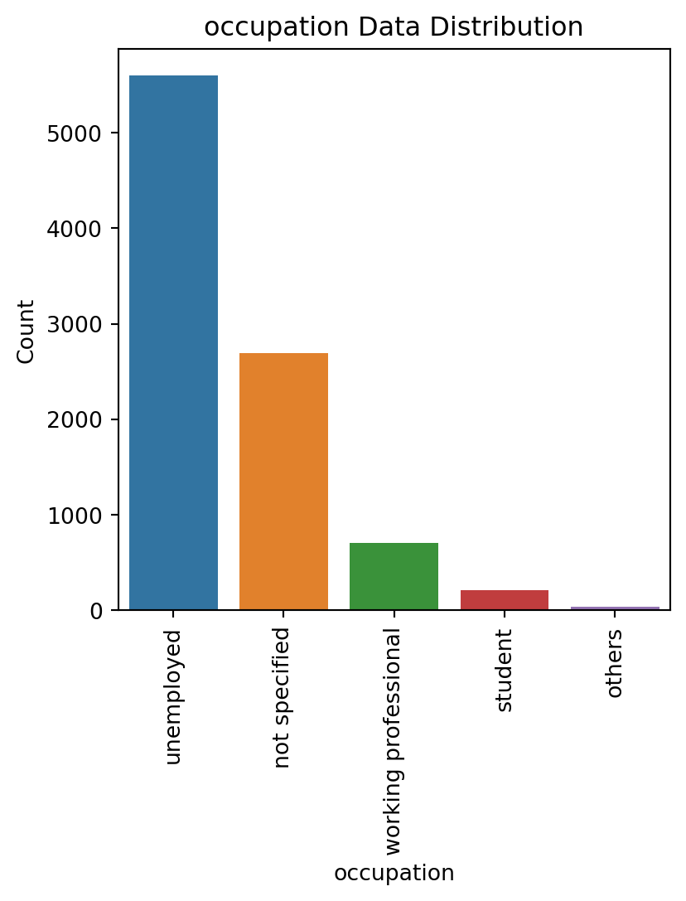
Insights From EDA
Occupation
Working Professionals are more likely to join the course
Leads from Unemployed Cutsomers have moderate chance of conversion
Students are less likely to join the course

Slide 6
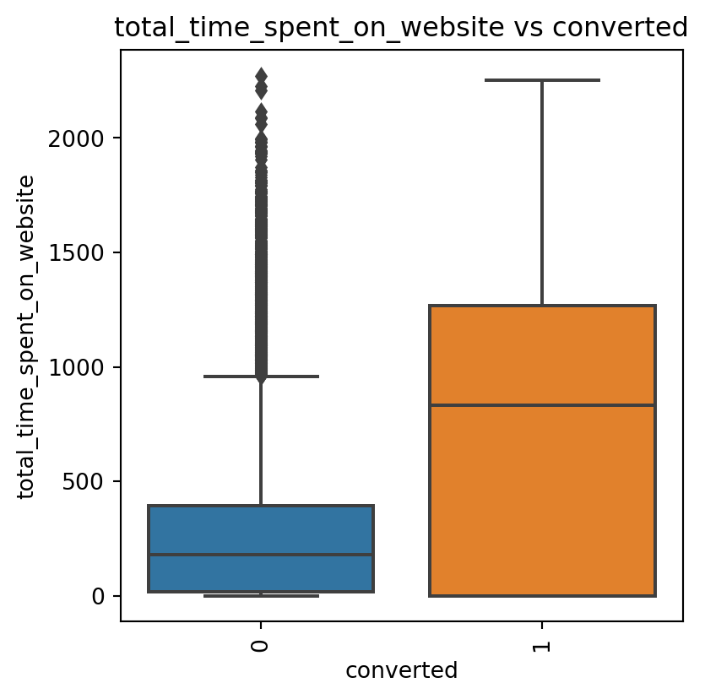
Insights From EDA
Total Time Spent On Website
People Who spend more time on website are more likely to convert

Slide 7
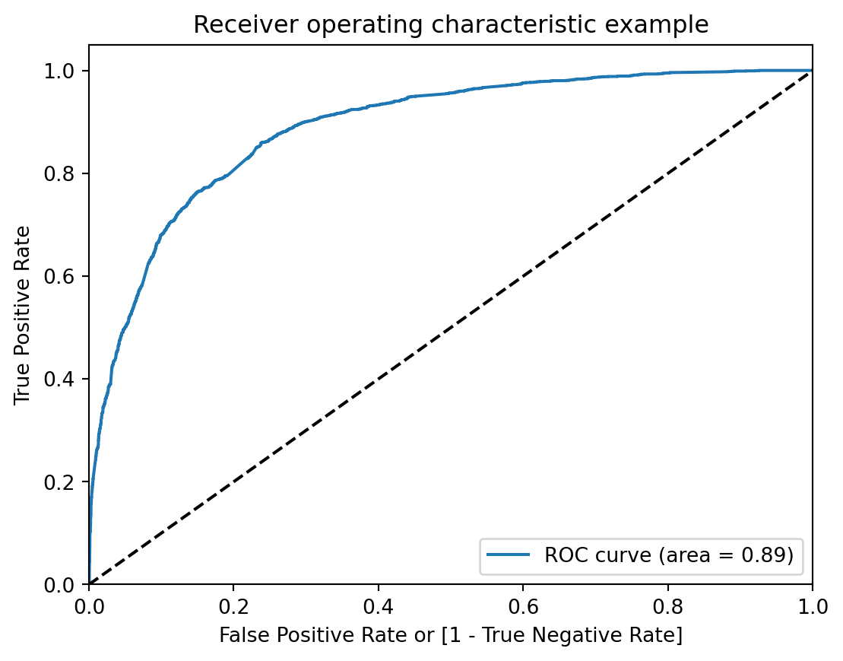
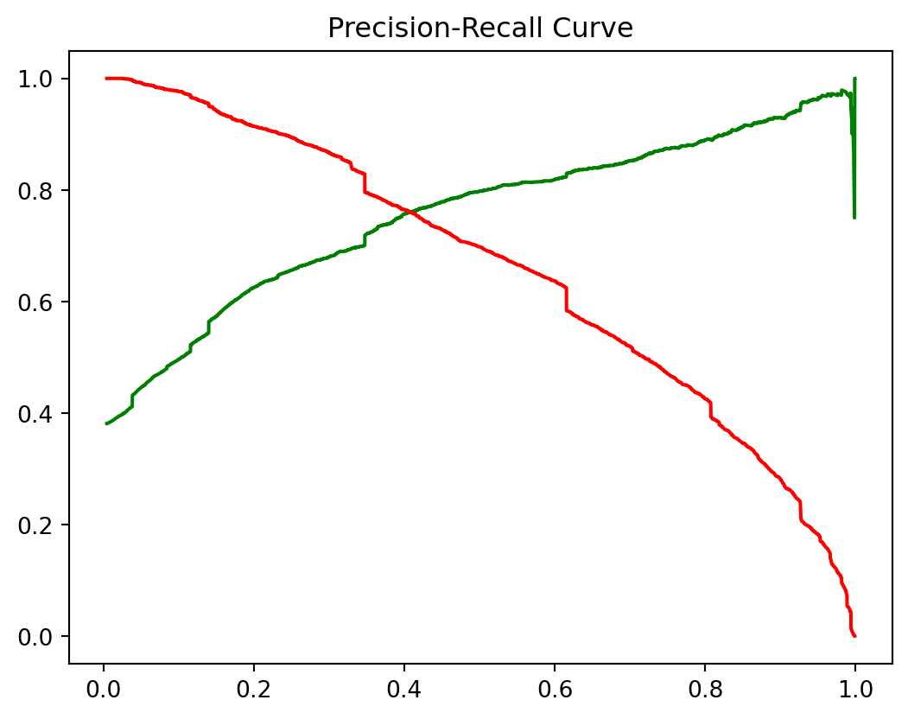
Model Evaluation
ROC
ROC is 0.89, which indicates that our model is statistically good
Optimal Cut off is Around 0.37 – 0.4, we can Consider 0.37

Slide 8
Model evaluation
Accuracy, Specificity, Sensitivity/Recall, Precision and FPR
Key Metrics
 | Train | Test
Accuracy | 0.81 | 0.80
Specificity | 0.78 | 0.77
Sensitivity/Recall | 0.82 | 0.83
Precision | 0.74 | 0.75
FPR | 0.17 | 0.16

Slide 9
Top 10 features
Key Metrics
 | Co-efficient
lead_source_welingak website | 3.983940
occupation_working professional | 3.717404
occupation_others | 2.224231
lead_source_reference | 2.062279
last_activity_others | 1.699773
lead_source_google | -1.144451
do_not_email_1 | -1.239934
lead_source_referral sites | -1.244498
lead_source_organic search | -1.318488
lead_source_direct traffic | -1.560190

Slide 10
Growth Strategy
Support team can contact if a lead belongs to any of these categories:
Customer is Working Professional
Lead was obtained from Welingak Website
Lead was obtained through referral
Support team can give lower priority if lead belongs to any of these categories:
Lead was obtained from Google, direct visit or referral sites
Customer did not opt for email communication

Slide 11
THANK YOU
Girish, Saurabh and Monika

